Slide 1
WEBSITE PUBLISHING SYSTEM
By
A. Abhineeth reddy, 11rjia0502
B. Ram Prasad, 11rjia0514
d. sai nath, 11rj1a0527
Project Guide: Mr. N. Sateesh

Slide 2

Project Overview
The aim of this project is to create a website publishing software that emphasizes on decentralization of activities.
Using different modules for respective activities, the project focuses on providing access to all the participants of a business environment.

Slide 3

The existing system
Disadvantages:
Labor intensive.
Higher time complexity.
An age old method where creativity is limited.
Utilizes a lot of stationery and results in inevitable wastage.
Lack of Transparency.
Slow and cumbersome rate of communication.

Slide 4

The proposed system
Advantages:
Emphasizes on automation.
Reduces the time complexity.
Reduces use of stationery, proposes digitization.
Increases transparency.
Increases the visual appeal of the product ads.
Communication between all the parties involved is swift and efficient.

Slide 5

Minimum Requirements
Software Requirements:
Operating System: Windows XP Service Pack 2
Technology: Java/J2EE(Servlets,JSP,JDBC)
Web Technologies: HTML,JavaScript,CSS
Web Server: Tomcat 6.0/ Glassfish 4.0
Database: Oracle 10g Express Edition
Software: JDK 1.6
Hardware Requirements:
Hardware : Pentium based systems with a minimum of P4
RAM: 256 MB(Minimum)

Slide 6
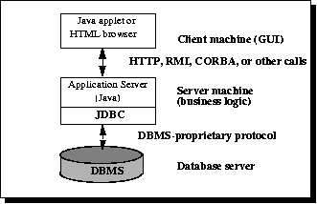
Three-tier architecture

Slide 7

Modules
The following are the modules of the system:
Product Publishing Module
Tender Publishing Module
Event or Visiting Publishing Module
News Publishing Module
Advertisement Publishing Module

Slide 8



Actors
Administrator
Employee
Client

Slide 9
Administrator
Use case diagram

Slide 10
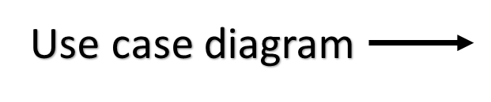
Employee

Slide 11
Client
Use case diagram

Slide 12
Class diagram

Slide 13
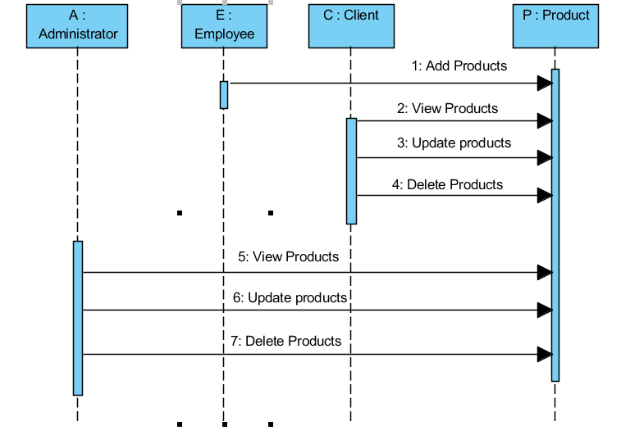
Sequence diagram for products

Slide 14
USE CASE DIAGRAM FOR PRODUCTS:

Slide 15
USE CASE DIAGRAM FOR TENDER MANAGEMENT:

Slide 16
USE CASE DIAGRAM FOR NEWS:

Slide 17
USE CASE DIAGRAM FOR ADVERTISEMENTS:

Slide 18
USE CASE DIAGRAM FOR EVENT / VISITOR:

Slide 19
Activity diagram
For Admin:
No
Authentication
Yes

Slide 20
Activity Diagram
for Employee
No
Authentication
Yes

Slide 21
Activity Diagram
for Client
Login
No
Authentication
Yes

Slide 22
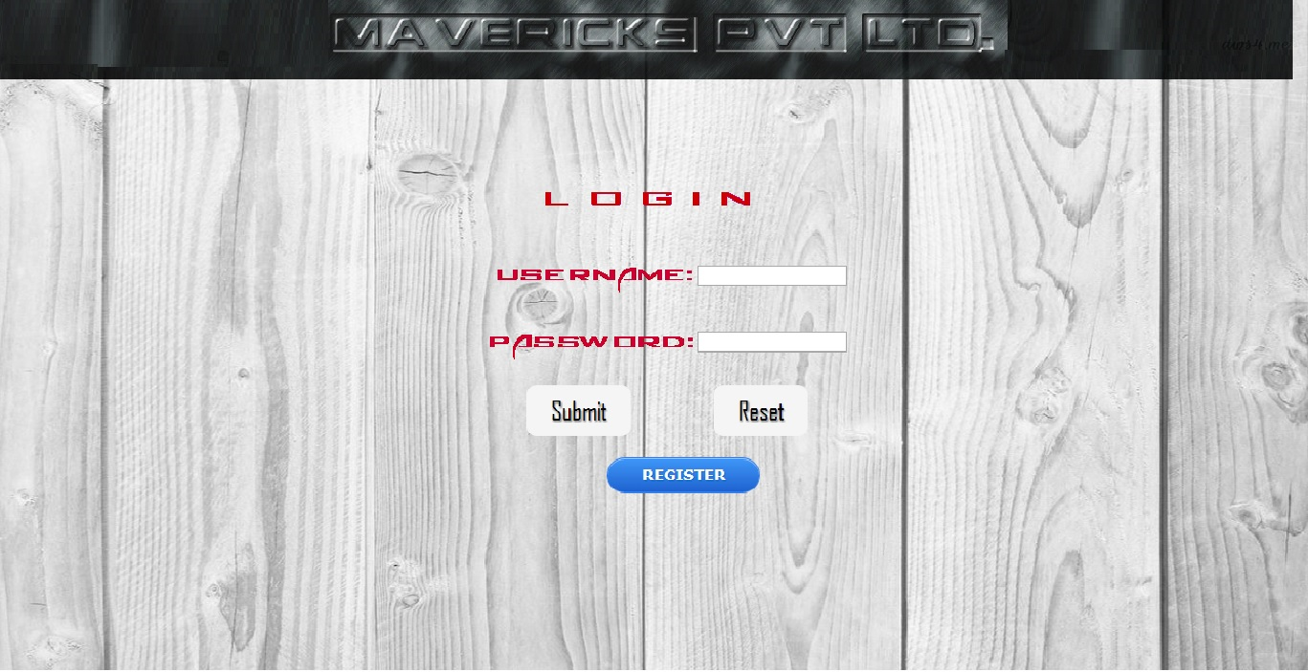

Slide 23
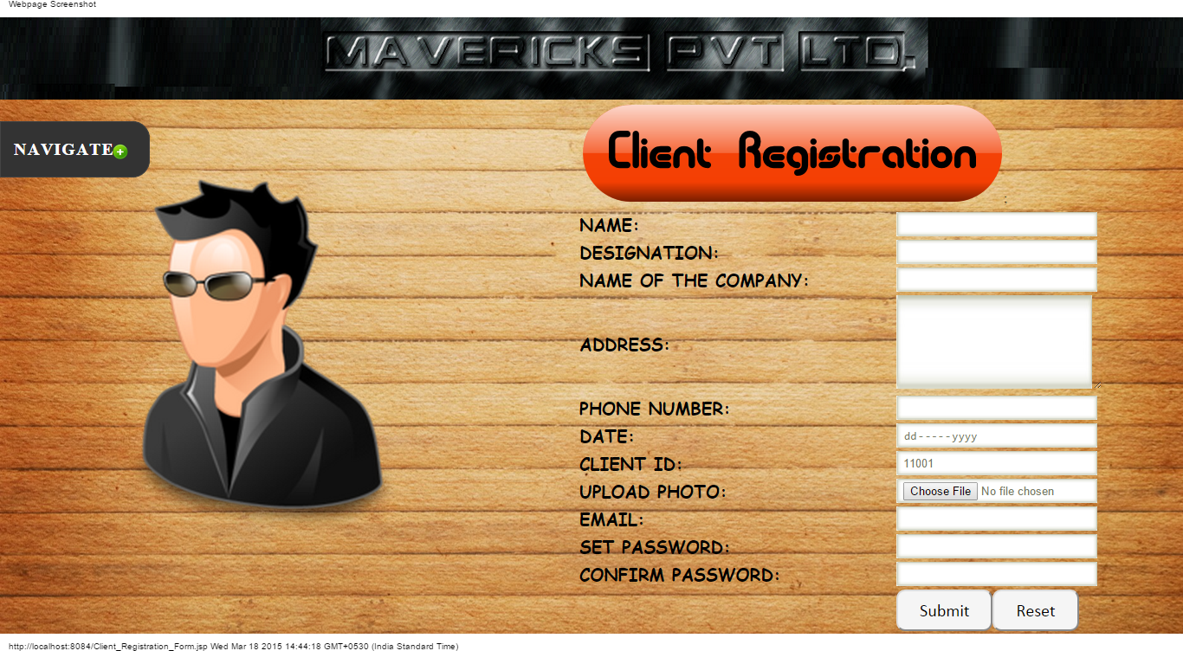

Slide 24
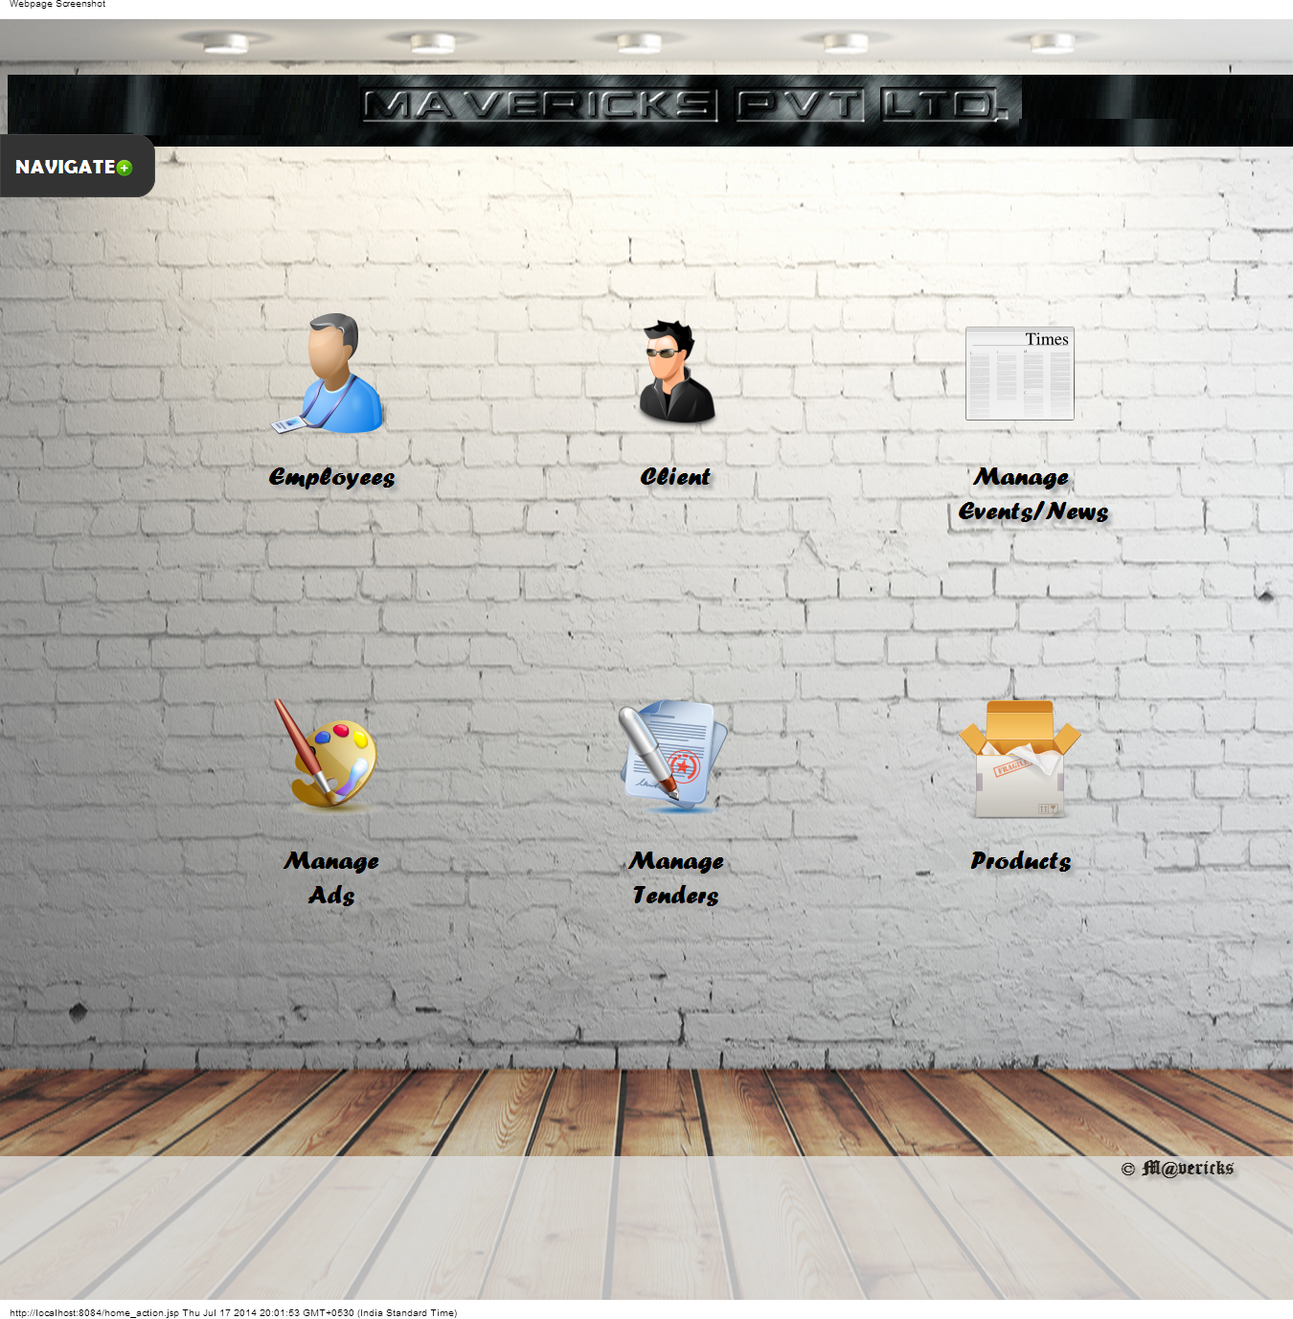
Admin home page

Slide 25
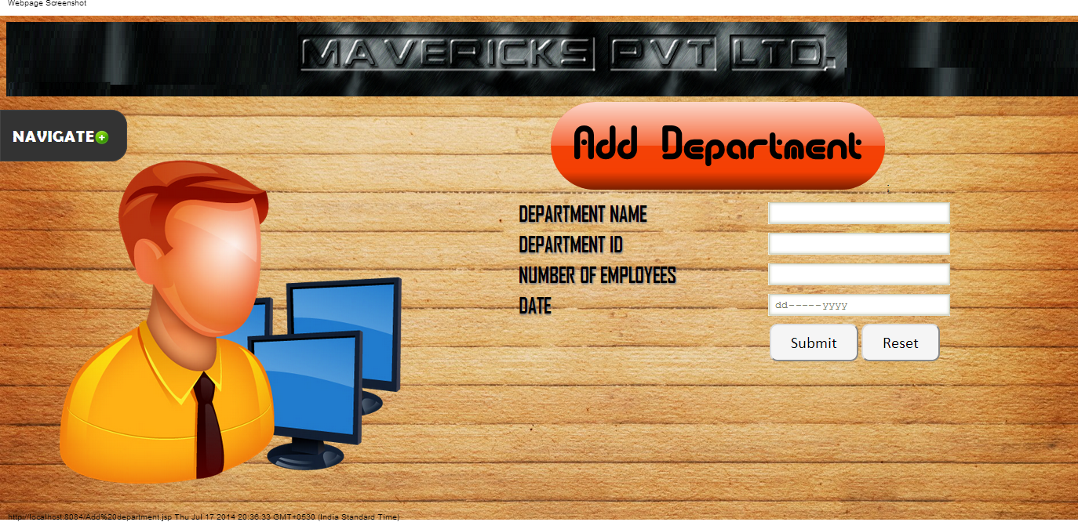

Slide 26
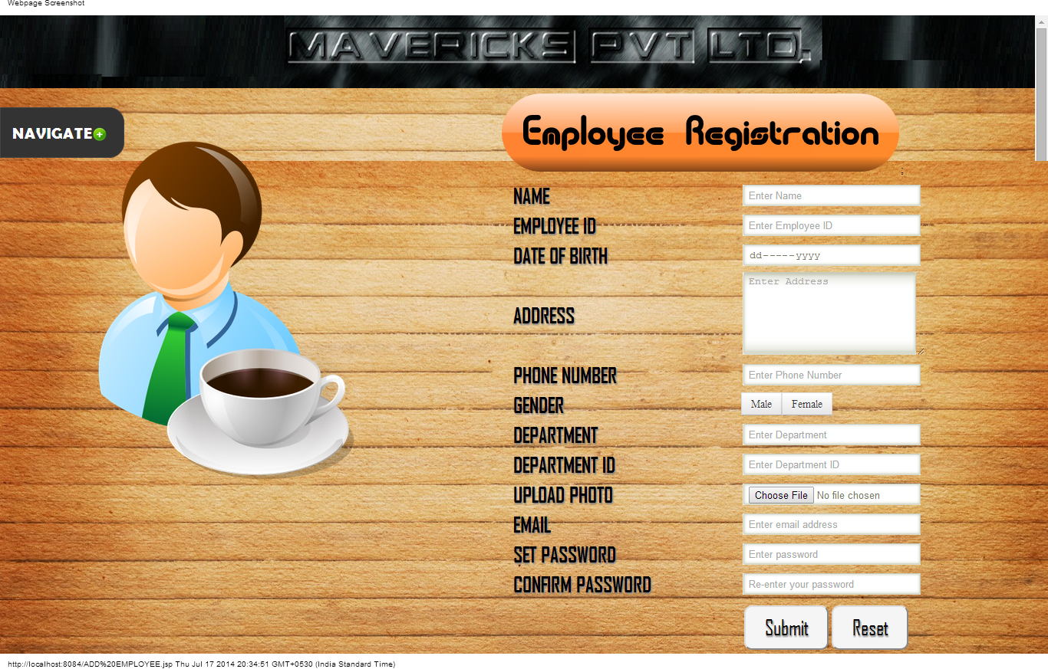

Slide 27
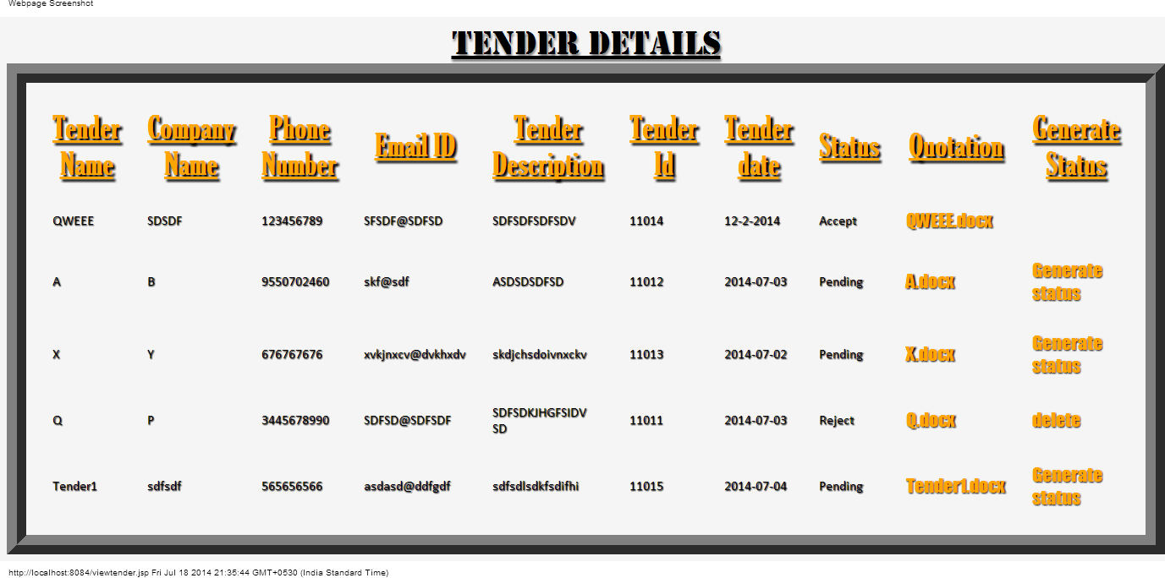

Slide 28
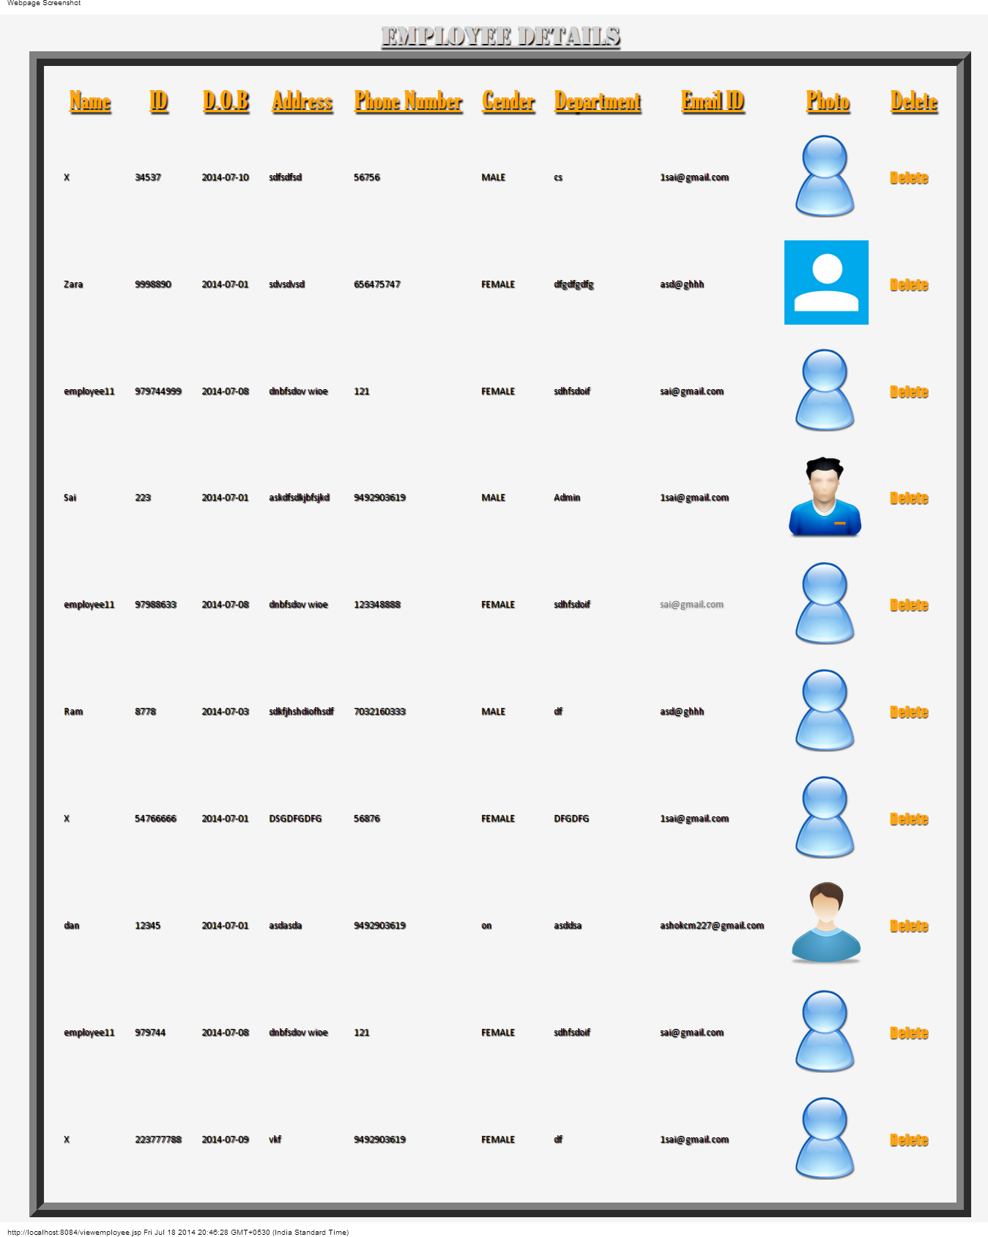

Slide 29
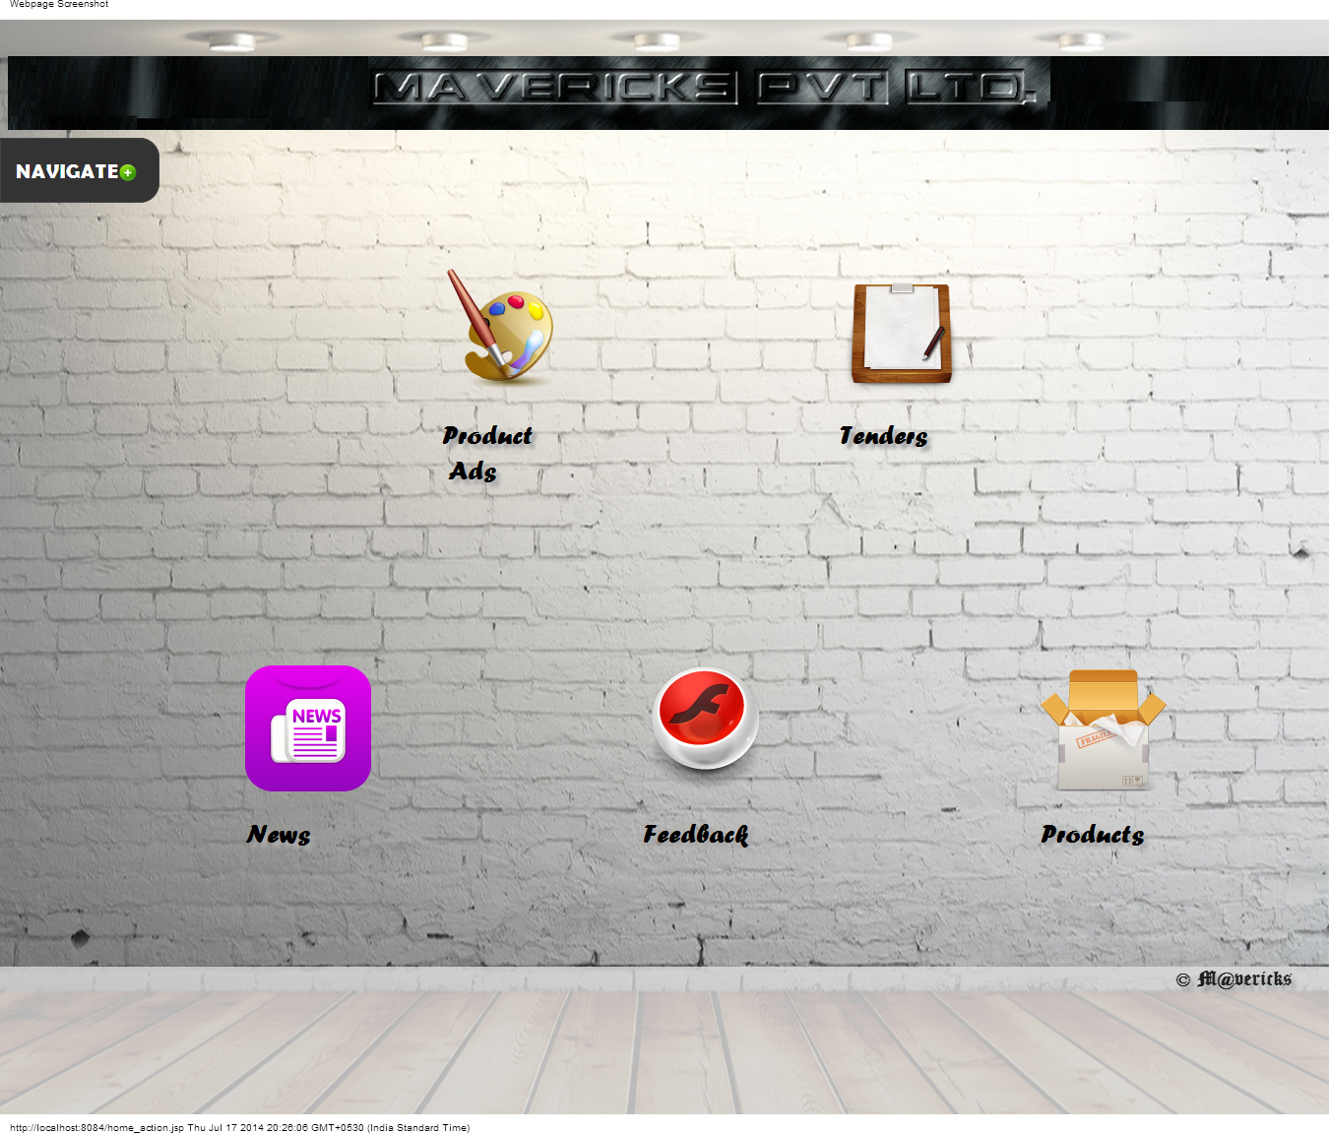
Client home page

Slide 30
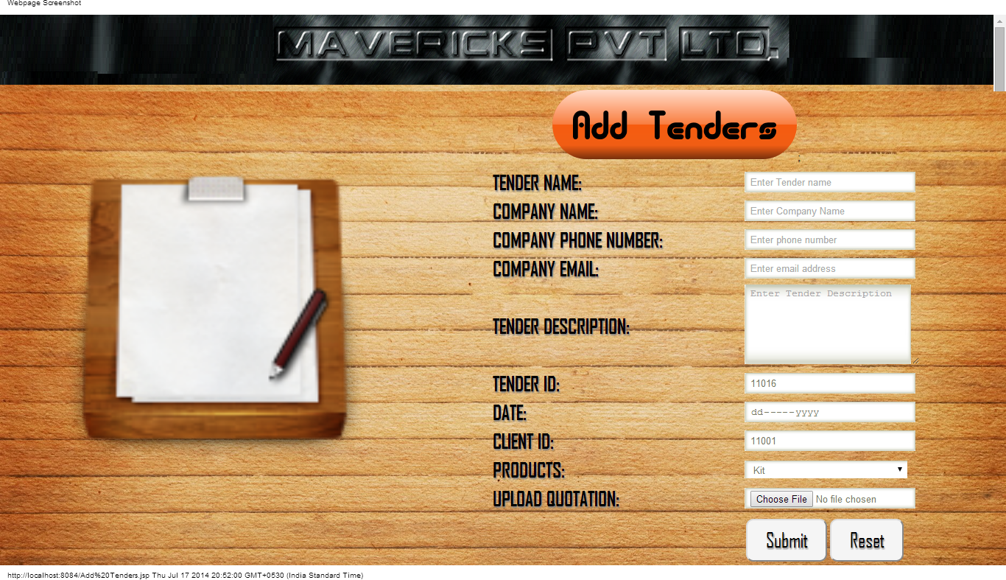

Slide 31
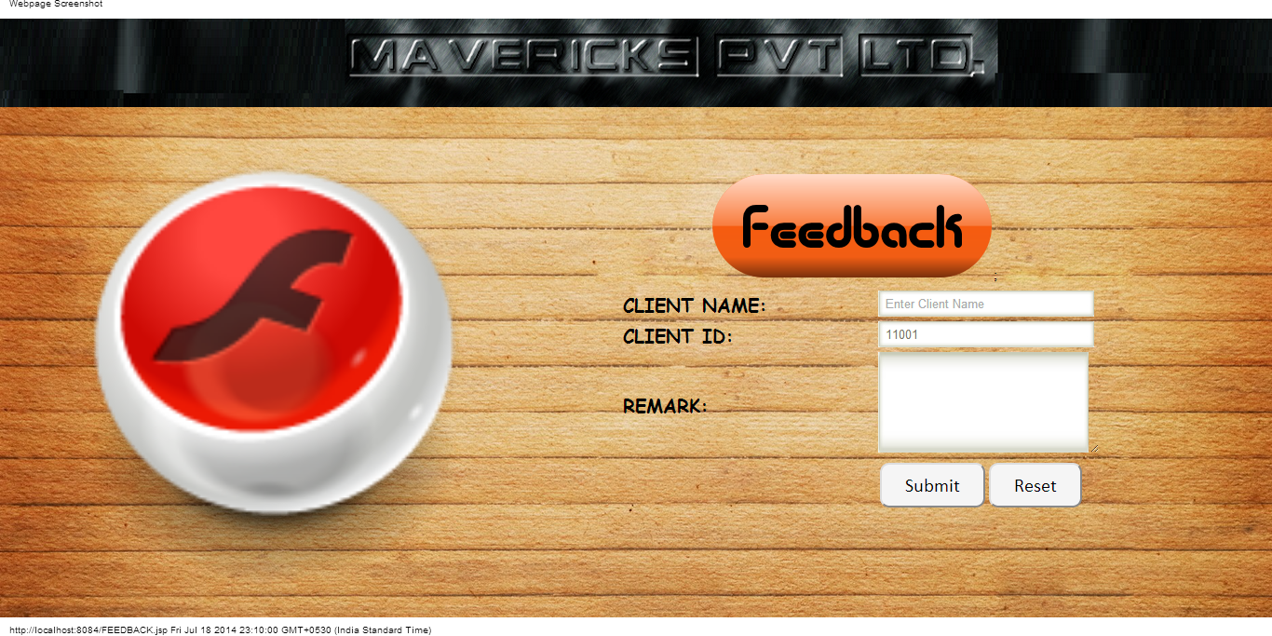

Slide 32
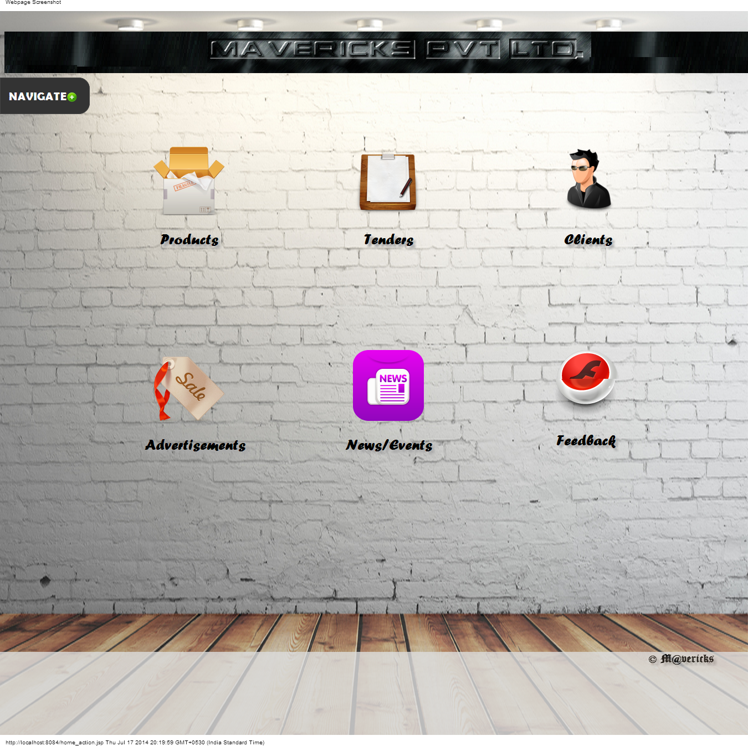
Employee home page

Slide 33
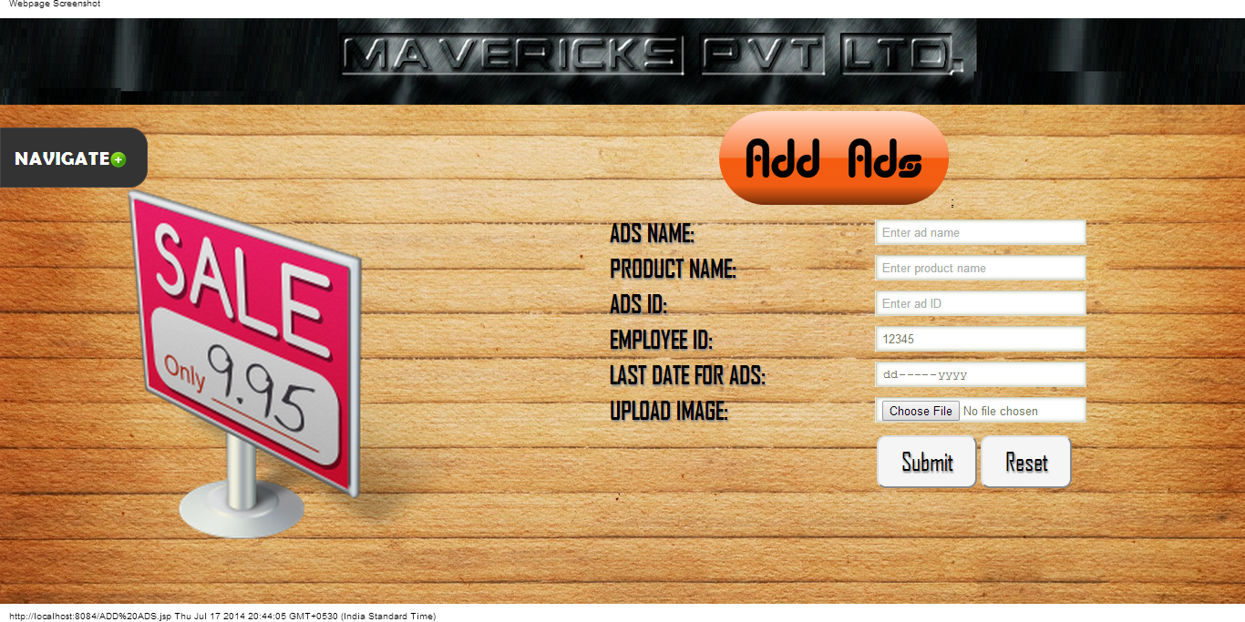

Slide 34
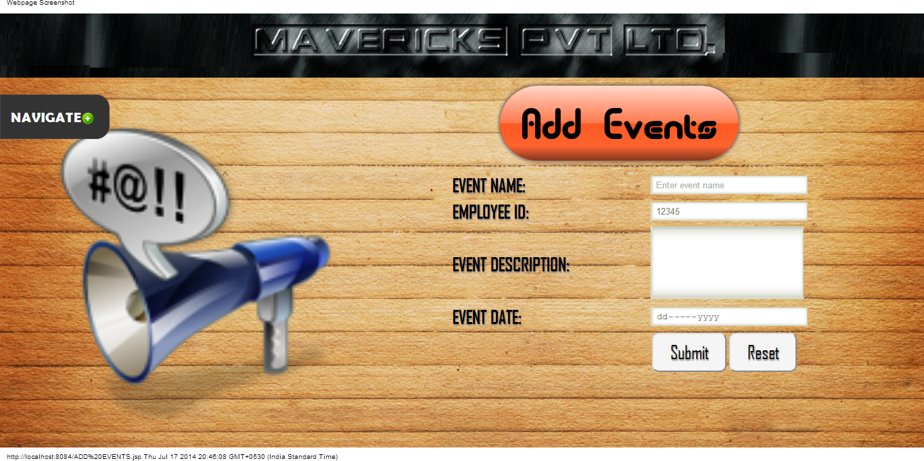

Slide 35
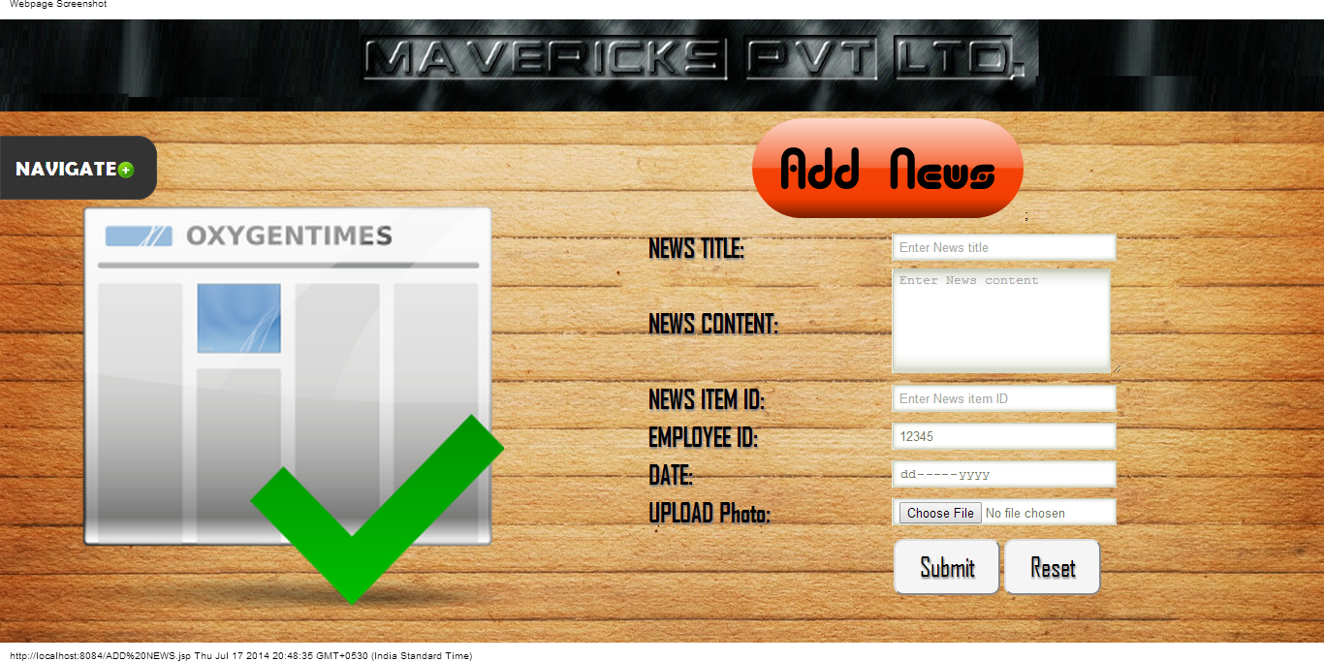

Slide 36
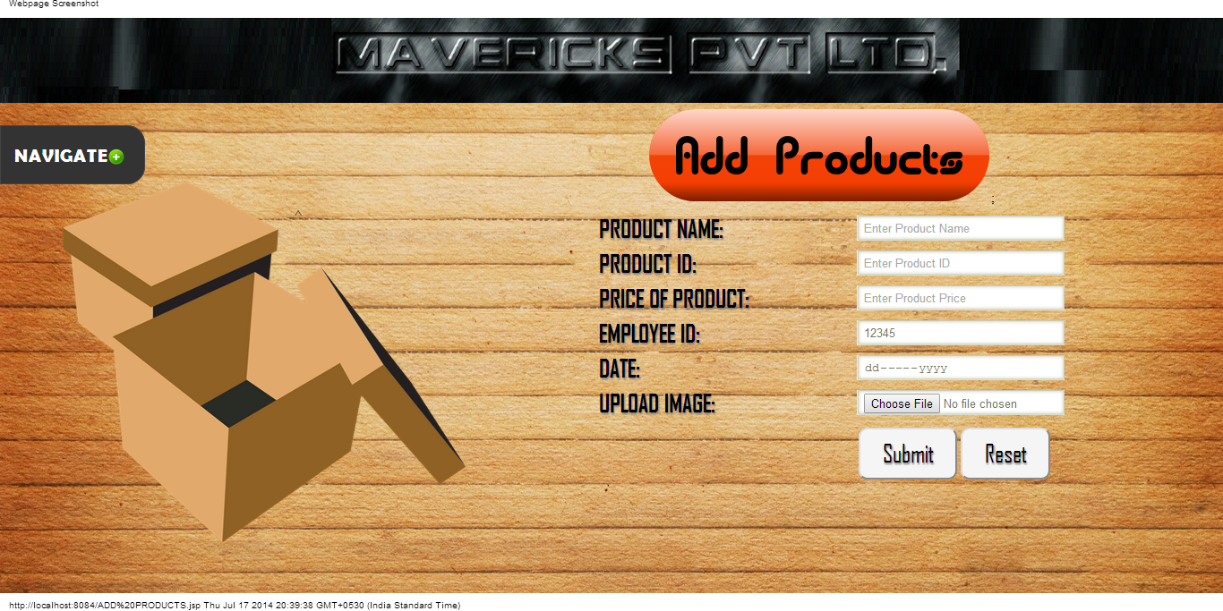

Slide 37
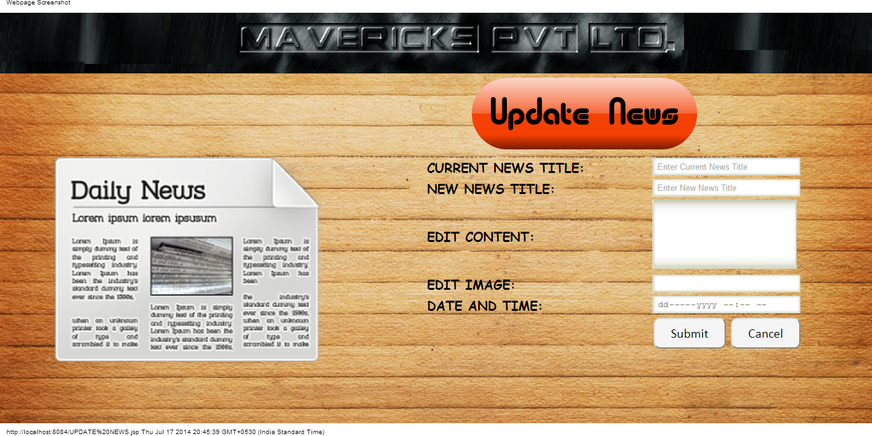

Slide 38
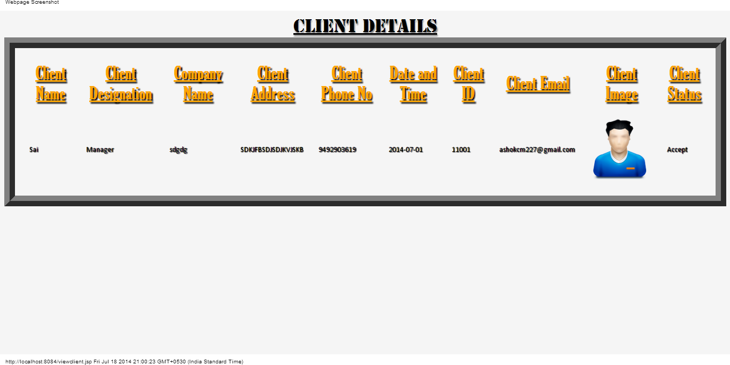

Slide 39
Technology made large populations possible; large populations now make technology indispensable.
–Joseph Wood Krutch

Slide 40
Thank You
Any Questions?

